Slide 1
Text Annotation 101

Slide 2
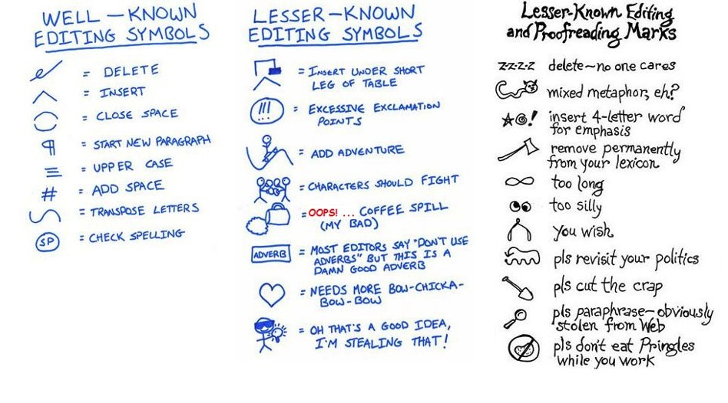
Text Annotation by Teachers
Notes:
These are editing symbols. In text annotation, students may elect to use symbols or tiny drawings, in addition to underlining, bracketing, circling, or writing comments or questions,

Slide 3

What is Text Annotation?
While reading, students mark the pages for
Important information
Text meaning or key details
Ideas and questions
Notes:
Some readers mark the text extensively; some readers only mark the parts they think are important or problematic. It’s not essential how MUCH students annotate, only that they DO annotate. The act of marking the page while reading makes it more likely that students will read closely and attentively.

Slide 4

What About Highlighters?
Students often think text annotation simply involves highlighting almost every word in a text.
Notes:
It’s important to note that highlighting may be part of student’s system for annotation but it is NOT effective if it’s the only system.

Slide 5

What About Highlighting?
Harvard University puts incoming students on notice about the effectiveness of highlighting…
Notes:
This comes from Harvard University Advice to Incoming Students.

Slide 6

Highlighting Dilutes Comprehension
“First of all, throw away the highlighter in favor of a pen or pencil.
Highlighting can actually distract you from the business of learning
and dilute your comprehension”(2005).
Notes:
Please point out how distracting and complicated this seems. Also, if the reader doesn’t remember the color code, this could be meaningless later.

Slide 7
Improves Comprehension
Note-taking activities have a positive impact on reading comprehension
Twenty-one of twenty-three studies (91%) showed a positive outcome
Notes:
From Writing to Read—annotation is considered a note-taking strategy, something students must learn to do—and something that is taught infrequently in school.

Slide 8
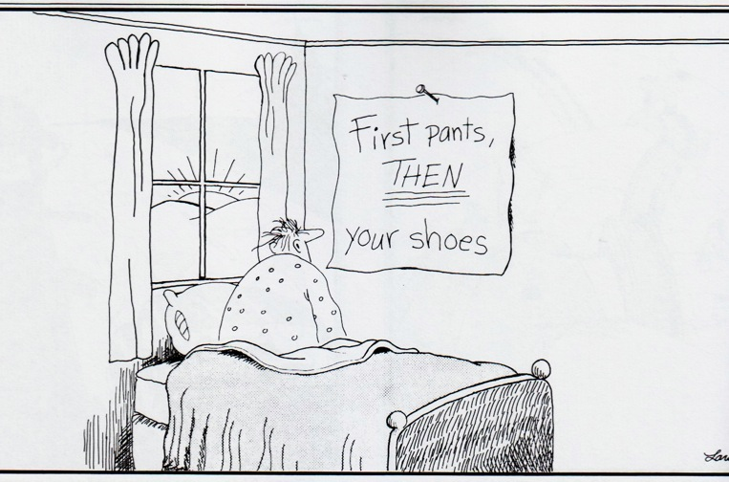
Teaching different annotation styles helps students discover what works for them.
It’s important to expose them to different ways to annotate texts while they read. Over time, the students will gravitate to those that fit their individual needs best. However, they need to learn that there are MANY styles and strategies.
Notes:
Teachers need to both teach annotation explicitly and teach multiple annotation styles. One reason students resort to only using highlighters is that they don’t know any other to note important information while they read.

Slide 9
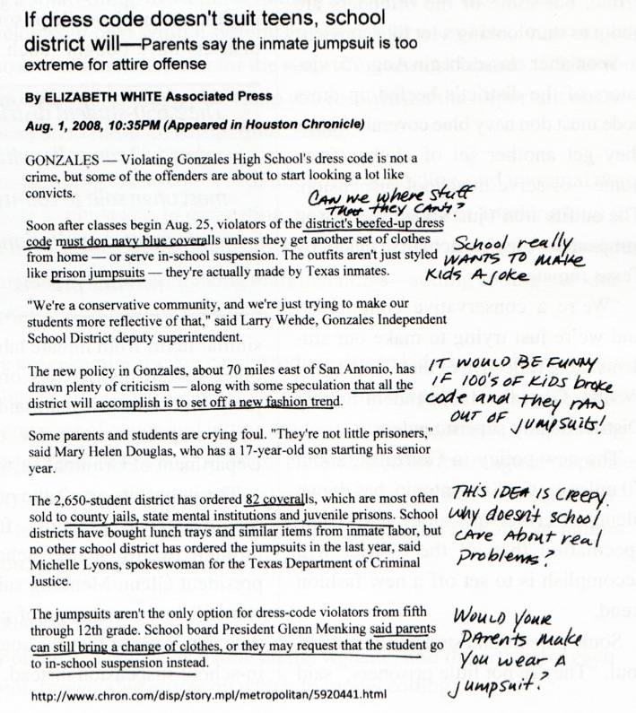
Annotation Styles and Strategies
Bracket [important] passages
Notes:
The following seven slides illustrate multiple annotation styles. Move quickly through these as they are fairly self-explanatory. All of the annotation styles can be used at the same time by students while they read, depending on the purpose and comprehension level of the reader. Bracketing works for larger sections of text (like quotes, lines from other works, text within text). Labeling by the the brackets helps identify why the bracketed text is important.

Slide 10
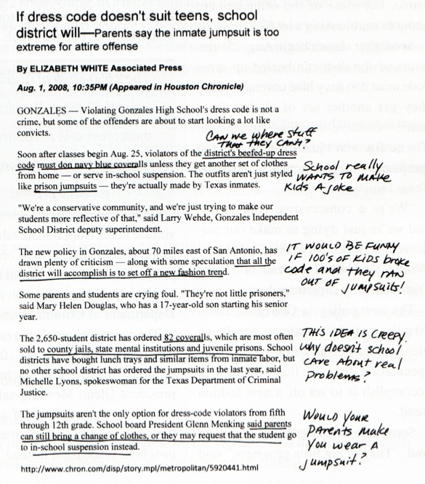
Annotation Styles and Strategies
Connect related ideas with lines
Underline important ideas/details
Notes:
Underlining important and key ideas allows readers to find essential information without having to reread the entire text. When sections of text are connected, drawing lines or arrows between connecting ideas allows the reader to “see” those connections without having to reread the entire text. It also helps readers make critical text-to-text connections while they read.

Slide 11
Annotation Styles and Strategies
Outline main ideas in margin
and/or
Write margin notes (comments and questions)
Notes:
Margin notes are essential and can include comments, questions, and symbols that the reader understands. By both reading AND writing while reading, comprehension is improved.

Slide 12

Annotation Styles and Strategies
Pneumonoultramicroscopicsilicovolcanoconiosis
Circle unfamiliar vocabulary
https://www.youtube.com/watch?v=li7HFKEkVOw
Notes:
This is a real word. It’s a disease of the lungs caused by inhaling small particles of dust from a volcanic eruption. Circling unfamiliar words (and sometimes looking them up in a dictionary or glossary) if there are no context clues within the reading, helps the reader know what questions to ask about the reading to improve his/her comprehension. It’s also a step frequently ignored by poor readers who skip over unfamiliar words and who never review them, even when reading in context doesn’t work.

Slide 13
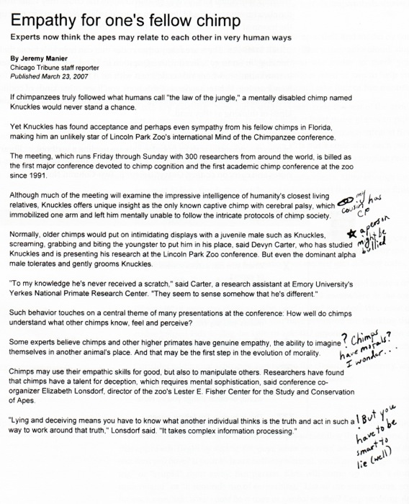
Annotation Styles and Strategies
Place asterisks or exclamation points next to unusual or surprising details
****
Notes:
Using asterisks or exclamation points next to unusual or surprising details allows readers to attend to the details and then move on to the more important or key details in the reading.

Slide 14
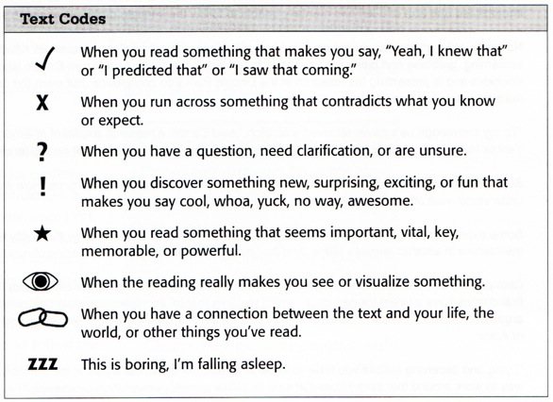
Annotation Styles and Strategies
Use symbols, drawings, and small drawings(text coding) to highlight important details
When using text coding, consistency is important. Students need to understand the key.
Notes:
If students are using text codes, emphasize that there needs to be some consistency in the coding so that students remember what the symbols mean.

Slide 15

Annotation Styles and Strategies
Can’t write in books?
Label with sticky notes—Students can use all the same strategies by placing their annotations on sticky notes on the pages of their books.
Copy important sections from text (doesn’t break copyright if used for educational purposes)
Notes:
This strategy works best with limited amounts of text. It can also be cost prohibitive because someone has to buy the sticky notes.

Slide 16
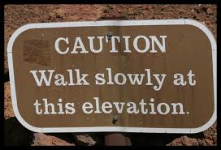
Challenges and Tips
Annotation slows down reading but increases comprehension.
Good readers don’t believe it works or don’t think it’s necessary.
Circle new vocabulary words
Underline new characters and place names.
Write your own thoughts and opinions in the margins
Notes:
Have students read short, complicated material without requiring any annotation. Don’t allow students to refer to the text during the quiz. After the quiz, see what details students forgot. Use this as the basis for your discussion about the necessity of writing while reading. After students complete a reading assignment with required annotations, evaluate if they did better. Allow them to use their annotated texts on tests, etc. Students discover that annotations allow them to find essential information quickly.

Slide 17
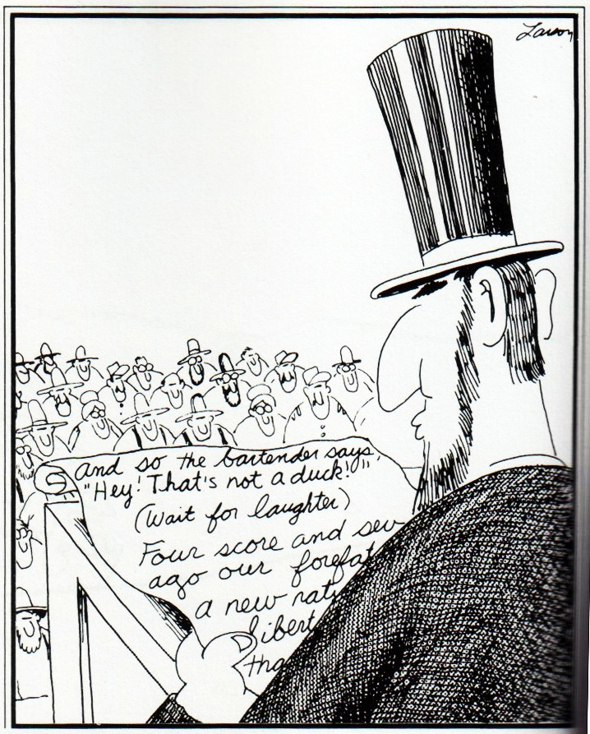
Notes:
Annotation is often seen in scripts as stage direction.

