Slide 1
The Art of Persuasion

Slide 2
Forms of Persuasive Writing
Advertisements
Editorials
Speeches
Propaganda
Reviews
Blogs
Persuasive Essays

Slide 3
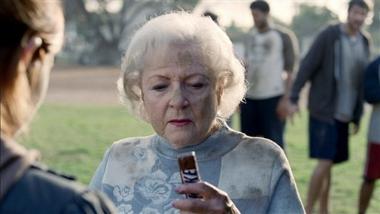
Forms of Persuasive Writing
Advertisements try to convince you to do or buy something.

Slide 4
Forms of Persuasive Writing
Editorials about current issues appear in newspapers and magazines, or on television, radio, and the internet.
http://topmagazines.wordpress.com/2011/06/29/recommended-magazines-for-people-who-can%E2%80%99t-get-enough/

Slide 5
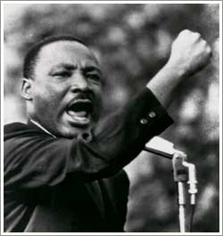
Forms of Persuasive Writing
Persuasive speeches try to convince an audience to take action
http://www.pbs.org/wnet/historyofus/web14/index.html

Slide 6
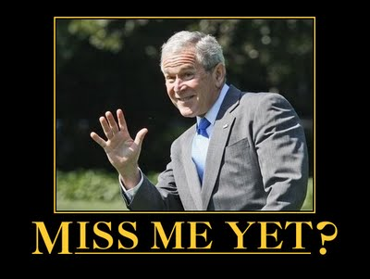
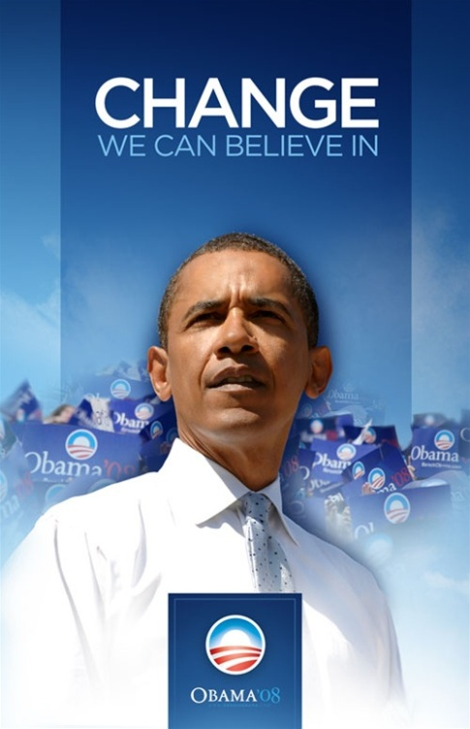
Forms of Persuasive Writing
Propaganda is often about political issues, and usually includes emotionally charged appeals.
http://www.zazzle.com/change_we_can_believe_in_poster-228719897857931246 http://www.zazzle.com/miss_me_yet_george_bush_billboard_postcard-239692539098456593
Notes:
A campaign poster for Barack Obama and a billboard advertisement that was displayed on Interstate 35 between Dallas and Austin in Texas

Slide 7
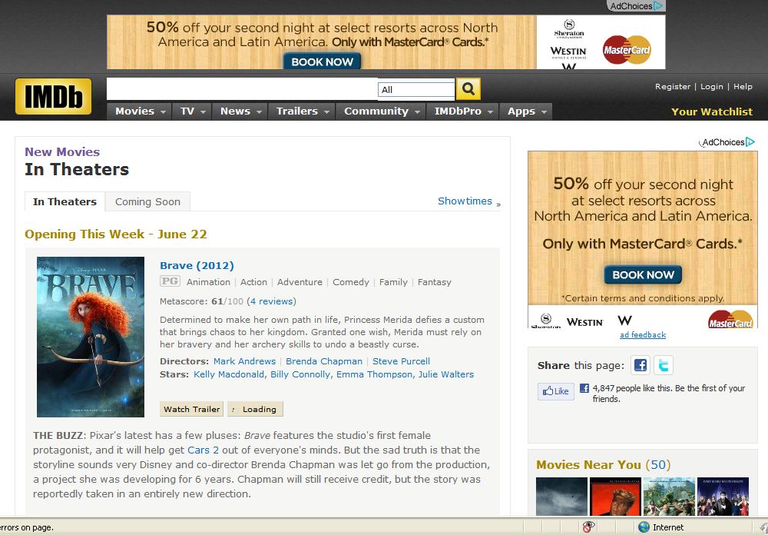
Forms of Persuasive Writing
Reviews evaluate items like books or movies and state an opinion as to whether the product is worth the reader’s time and money.
http://www.imdb.com/movies-in-theaters/

Slide 8
Forms of Persuasive Writing
Blogs provide commentary on a particular topic, often combining text, images, and links to other blogs, web pages, and other media related to its topic. Blogs also allow readers to respond.
http://www.ted.com/talks/marcel_dicke_why_not_eat_insects.html

Slide 9
Forms of Persuasive Writing
Persuasive essays use logic, reason, and emotion to convince readers to join the writer in a certain point of view.
http://www.essay.tv/wp-content/uploads/2010/01/how-to-write-essay.jpg

Slide 10
The Persuasive Essay

Slide 11
A persuasive essay convinces readers to agree with the writer’s opinion
The lead/hook captures the reader’s attention
The thesis states the writer’s assertion (belief) about the topic
The supporting arguments (logos, pathos, ethos) convince the reader that the thesis is correct
Optional counter arguments respond to reader concerns and objections
The conclusion restates the thesis (comes back to the point)
Notes:
Counter arguments are listed here as optional. Depending on the length of the essay, counter arguments may be omitted. Notice that the components have been color coded. They are color coded throughout this presentation. As an extension activity, students could use the color codes here to highlight mentor texts.

Slide 12
Lead / Hook Grab the Reader’s Attention
Anecdote (narrative vignette) | I walked proudly through the hallways of AMS, my new blue mohawk glistening magnificently in the florescent lighting of the hallway, but then I saw Mr. Caruthers. I felt the wax in my hair start to melt.
Question | Do schools have the right to tell kids how to dress?
Hyperbole | For the past 300 years in this country, schools have been crushing the artistic freedom of students with oppressive dress codes!
Setting | At Centerville Middle School, a controversy is brewing. Walk down the hallways, and amidst a tranquil sea of khaki pants and navy blue polo shirts, the blades of a fuchsia mohawk cut through the peaceful learning environment.
Alliterative Phrase | Timeless. Tasteful. Tried and true. The traditional school uniform is the foundation of a true learning environment.
Quotation | “Give me liberty or give me death.”
Notes:
Here are some possible leads for a persuasive paper about school dress codes. Have students consider tone and audience. Which would be most appropriate?

Slide 13
Thesis and Forecast
A thesis statement is always one sentence that states your assertion (belief) about a topic. A thesis statement usually includes a forecast (brief preview of your arguments).
(I believe) ____________________ because of argument 1, argument 2, and argument 3.
Notes:
Introduce the thesis statement model. Have students practice writing thesis statements with the “I believe” stem until they become proficient. Some students may only need to be shown the example once—others may have to write four or five essays using the stem until they get the idea. I refer to the “I believe” stem as the “training wheels” for thesis statements. Once students are confident in their ability to write thesis statements, they can get rid of the “training wheels.” Show students the correlation between the planner and the thesis statement and forecast.

Slide 14
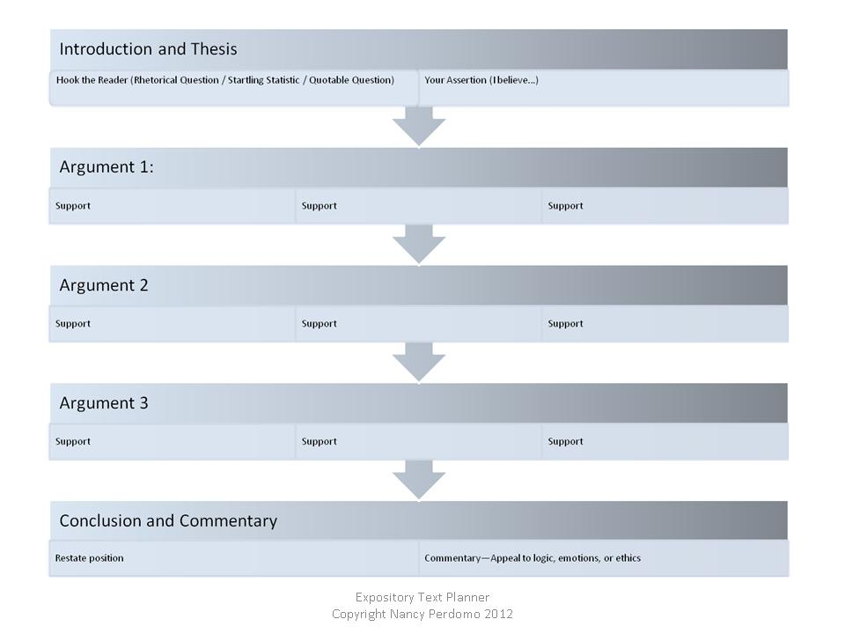
Text Structure of a Persuasive Essay
Notes:
Show students the correlation between the thesis and forecast and the planner.

Slide 15
Which of the following is a good thesis statement?
I believe we must stop wasting food now!
The problem of food waste can easily be solved by implementing three simple steps: reduce, reuse, recycle.
If you aren’t reducing, reusing, and recycling, you should.
I believe wasting food is a huge problem. We need to reduce our food waste. For example, make a shopping list before you go to the store, and only buy things you truly need. You shouldn’t buy a gallon of milk if you are only going to drink a quart of it during the week. Who cares if the gallon size is on sale?
Notes:
Have students analyze these typical student thesis statements. The first is missing a forecast. The third has an assertion, and previews the arguments, but the tone is not academic. This is a great opportunity to discuss with students the use of first person, second person, and third person points of view in academic writing. The final example starts with an assertion, but the writer then launches into the heart of the arguments. Stress to students that the forecast is a concise preview—the full argument and supporting details should go in the body paragraphs, not the introduction.

Slide 16
Supporting Arguments
Logical Appeal (Logos)—Does the author’s proposal make sense?
Ethical Appeal (Ethos)– Is the author’s proposal the right thing to do?
Emotional Appeal (Pathos)—Will accepting the author’s proposal make me feel better?

Slide 17
Types of Supporting Arguments
Logos—an appeal to logic
Often contain expert testimony
Often contain statistical information
Suggest that the product is the “logical” or “right” choice

Slide 18
Types of Supporting Arguments
Ethos-an appeal to do the “right” thing
http://en.wikipedia.org/wiki/Uncle_Sam http://marvel.com/images/gallery/story/15172/images_from_own_a_piece_of_the_captain_america_movie/image/857368
Notes:
Many students will have seen “Captain America” or “The Avengers.” Talk about why this particular ad, which is featured in the film, would appeal to the Captain American character.

Slide 19
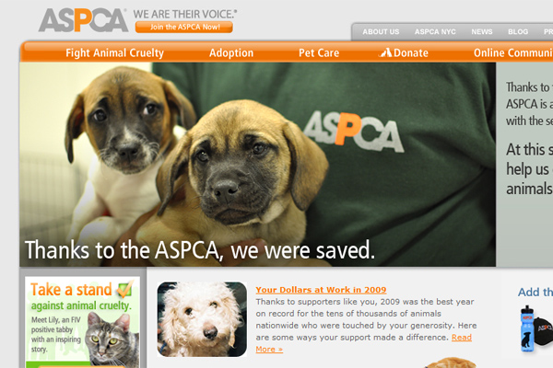
Types of Supporting Arguments
Pathos-an appeal to the emotions
http://46664.net/56/aspca-the-american-society-for-the-prevention-of-cruelty-to-animals/
Notes:
Discuss with students why sad images are often used in ads for companies that are soliciting donations. Discuss the effects of music in these ads as well—an example would be Sarah MacLachlan’s song “In the Arms of an Angel”

Slide 20
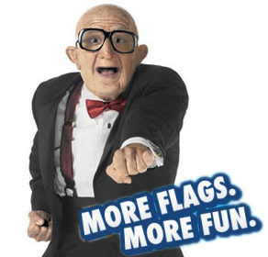
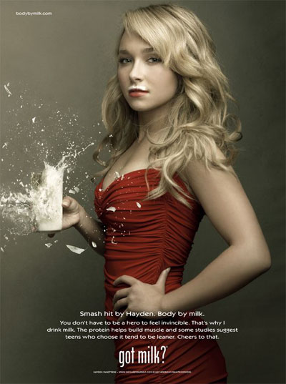
Not all emotional arguments are sad!
http://www.time.com/time/business/article/0,8599,1912454,00.htm lhttp://www.heroestheseries.com/masi-oka-and-hayden-panettiere-got-milk-ads/
Notes:
Discuss with students the power of the appeal of fun. This spokesman for Six Flags is a somewhat controversial choice in the business world. What about this “creepy old guy” suggests “fun” to young audiences? The desire to follow in the footsteps of a famous celebrity is also a powerful emotional appeal.

Slide 21
Counter Arguments Address Reader Objections
Oil companies should not be allowed to drill for oil in Alaska.
Schools should make overweight students eat diet meals for school lunch.
http://factbank.blogspot.com/2012/05/alaska-facts.html
http://www.heart.org/HEARTORG/GettingHealthy/Overweight-in-Children_UCM_304054_Article.jsp
Notes:
Have students come up with possible counter arguments to these two assertions.

Slide 22
Conclusion Restate the Thesis and Commentary
But one hundred years later, the Negro still is not free. One hundred years later, the life of the Negro is still sadly crippled by the manacles of segregation and the chains of discrimination. One hundred years later, the Negro lives on a lonely island of poverty in the midst of a vast ocean of material prosperity. One hundred years later, the Negro is still languishing in the corners of American society and finds himself an exile in his own land. So we have come here today to dramatize a shameful condition.
And when this happens, when we allow freedom to ring, when we let it ring from every village and every hamlet, from every state and every city, we will be able to speed up that day when all of God's children, black men and white men, Jews and Gentiles, Protestants and Catholics, will be able to join hands and sing in the words of the old Negro spiritual, "Free at last! free at last! thank God Almighty, we are free at last!"
http://www.huffingtonpost.com/2012/01/16/i-have-a-dream-speech-text-martin-luther-king-jr_n_1207734.html
Notes:
Have students compare these excerpts from Martin Luther King Jr.’s famous “I Have A Dream” speech. This is an excellent example of a conclusion that wraps back around to the theme introduced in the introduction. Emphasize to students that restating the thesis doesn’t mean that you simply recopy your thesis sentence, and change one or two words. The conclusion should revisit the author’s position established in the thesis statement—and reiterate the author’s vision going forward.

Slide 23
Text Structure of a Persuasive Essay
Notes:
Take this opportunity to review the structure of a persuasive essay.

Slide 24
Audience and Author’s Purpose
When writing persuasively, always remember the interaction between the writer and the reader. The writer is trying to persuade a reader who may be enthusiastic or resistant or simply disinterested. Persuasive writing must be well organized, but it must also hook the reader, and then keep him or her engaged with creative and authentic word choice.
Notes:
Discuss with students that writing free of grammatical and spelling errors is more credible. An example of asyndeton has been purposefully added to this comment. Older students can debate the effectiveness of the choice to leave out the commas in series as a style choice. Students might also discuss the use of texting language in online persuasive writing—is it appropriate? Is a formally written blog or response more or less credible than a response written in texting language. (LOL u r so right! Vs. I agree that recycling is a great way to reduce food waste.)

