Slide 1
Studying Character in Fictional Works

Slide 2
Definition
Characters: the people in the story
Characterization: the process by which the writer makes the character seem real to the reader

Slide 3
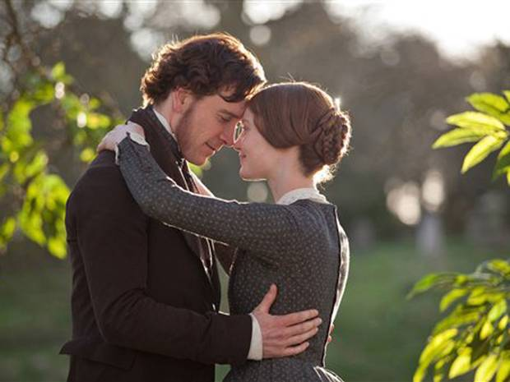
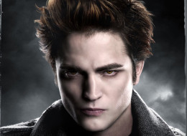
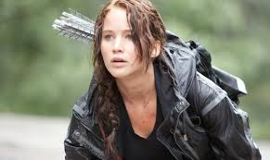
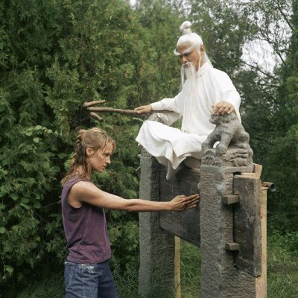
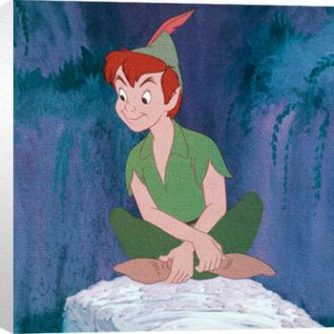

Slide 4
Character Types: Flat and Round
Flat character
Embodies 1 or 2 qualities, easily summarized;
Not psychologically complex and thus easily accessible to the reader;
Can be stock (based on a literary stereotype)
a character who possesses the expected traits of a group rather than being an individual

Slide 5
Character Types: Flat and Round
Round characters--
Complex and multi-dimensional
Inconsistent and unpredictable
Hard to summarize and understand
Display internal conflicts found in real people

Slide 6
The Shawshank Redemption, Tim Robbins and Morgan Freeman

Slide 7
Character Presentation
Direct (telling)
The writer tells what kind of person the character is.
Indirect (showing)
The writer presents the character in action and allows the reader to infer what kind of person the character is.

Slide 9
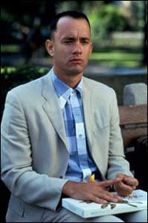
Character Behavior—Do They Change or Not?
Static character
Doesn’t change as a result of what happens to him in the story;
The reader’s knowledge of him does not grow.

Slide 10
Character Behavior
Dynamic character
Undergoes some kind of change as a result of action in the plot;
Must be a substantive change rather than a mood change.

Slide 11
Change or No Change. . .
A character must be
Motivated
Reader is offered reasons for how the characters behave, what they say, and what decisions they make;
Plausible
Action by a character that seems reasonable, given the motivations presented

Slide 12
Characterization
The method used by a writer to develop a character
Show the character’s appearance
Display the character’s actions
Reveal the character’s thoughts
Let the character speak
Get the reactions of others

Slide 13
Character Analysis
Physical. What does the character look like? How do the character’s physical attributes play a role in the story? How does the character feel about his or her physical attributes? How does the character change physically during the story? How do these changes affect the character’s experience?

Slide 14
Character Analysis
Intellectual. How would you describe this character’s intelligence? What does this character know? How does this character’s intellect compare to others in the story? Is this character smart enough to thrive in the world in which he or she lives? What does this character learn as the story develops?

Slide 15
Character Analysis
Emotional. How does this character feel most of the time? How do his or her feelings change throughout the story? How does this character feel about himself or herself? When faced with challenges in the story, what emotions come up for this character?

Slide 16
Character Analysis
Social. How does this character get along with other characters in the story? Who does this character choose for friends and why does this character choose them? Where does this character stand in the social order? How does this character’s social standing affect events in the story?

Slide 17
Character Analysis
Philosophical. What does this character believe about the way life is? What are these beliefs based on? How do these beliefs affect the choices this character makes? How do those beliefs change throughout the story? Do others in the story share these beliefs?

Slide 18
Final Thoughts
Weaknesses in a character, like vices, imperfections or flaws, make him or her appear more human-like, causing the audience to identify him/her self with that specific character.
This is a good characterization for a character in most fiction and non-fiction stories.

Slide 19
Task
Take a look at one of the characters in your novel.
Analyse them using some of the focus points that were covered in this presentation.
Share your findings with a partner at your table.

